Slide 1
Functions
Subrata Saha

Slide 2
Function
Function is a self-contained block of statements that perform some specific job.
Functions are categorized into two groups.
  Library function and
  User defined function.
Library functions are defined within several modules as per individual category of the functions.
User defined functions are defined according to our requirement.

Slide 3
Why Function
Increases Readability
Decreases LOC(Line of Code)
Minimize the effort in testing, debugging and maintenance
Increases Reusability
Helps in Top down modular programming
Helps to distribute tasks among team members

Slide 4
User-defined Function
The general form to define a user-defined function is :
  def function_name( list of Arguments ) :
  statement 1
  statement 2
  ……...
  [ return [expression]]
The general form of the function calling statement is
function_name(list of arguments)

Slide 5
Programming Example
Function to find the factorial of a number and its use from main.
def factorial( n) : # Function defination
f=1
for i in range(1,n+1) :
f=f*i
return (f)
x = int ( input (“Enter any Number : “))
fact = factorial(x) # Function call
print(“Factorial of ”, x, “is : ”, fact)

Slide 6
Types of function Arguments
The arguments can be classified into two types.
  Actual argument and
  Formal argument.
The arguments we send at the time of function call is known as actual arguments as they hold the actual value.
The arguments defined at the argument list in a function definition is known as formal arguments as they are formal place holder.

Slide 7
Programming Example
Function to find the factorial of a number and its use from main.
def factorial( n) :
f=1
for i in range(1,n+1) :
f=f*i
return (f)
x = int ( input (“Enter any Number : “))
fact = factorial(x)
print(“Factorial of ”, x, “is : ”, fact)
Formal Argument
Actual Argument

Slide 8
Function returning multiple values
def area_peri(l,b):
area=l*b
peri=2*(l+b)
return (area, peri)
len=int(input("Enter Length: "))
brd=int(input("Enter Breadth: "))
a,p=area_peri(len,brd)
print("Area=",a)
print("Perimeter=",p)

Slide 9
Local and global variables
Variables defined in the main body of the program file is known as Global variable
Variables defined within any function is known as local variable
Scope: portion of the program in which a variable is accessible.
Lifetime: duration for which a variable exists

Slide 10
Example
Global variable
x=5
def f1():
y=10
print(x,y)
f1()
print(x)
print(y) #Not accessible
Local variable

Slide 11
Using global statement
x=5
def f1():
global y
y=10
print(x,y)
f1()
print(x)
print(y)
Output : 5 10
5
10

Slide 12
x=5
def f1():
x=10
print(x)
f1()
print(x)
Output : 10
5

Slide 13
def f1():
global x
print(x)
x=10
x=5
f1()
print(x)
Output : 5
10
Output : Error

Slide 14
Keyword Arguments
def keyArgs( roll, name, grade) :
print("Roll=",roll)
print("Name=",name)
print("Grade=",grade)
keyArgs(name="Subrata",grade=8.2,roll=5)

Slide 15
Default Arguments
def printLine(ch="-",n=10):
print(ch*n)
printLine()
printLine('*')
printLine('*',5)
Output:
----------
**********
*****

Slide 16
Variable Length Arguments
Python allow us to take arbitrary number of arguments.
Syntax:
def function_name(……., *v)
statement(s)
[return [expr]]

Slide 17
Variable Length Arguments
def sum(*n):
s=0
for i in n:
s+=i
return s
print(sum(10,20))
print(sum(10,20,30,40))
print(sum())
Output : 30
100
0

Slide 18
Variable Length Arguments with formal arguments
def vlArgument(arg1, *vargs):
print("Formal argument:",arg1, "and variable length arguments:",vargs)
vlArgument('c', 'java')
vlArgument(5)
vlArgument()
Output:
Formal argument: c and variable length arguments: ('java',)
Formal argument: 5 and variable length arguments: ()
Traceback (most recent call last):
File "C:\Python34\test.py", line 7, in <module>
vlArgument()
TypeError: vlArgument() missing 1 required positional argument: 'arg1'

Slide 19
Nested functions
def outer():
num2 = 20
def inner():
num3 = 30
print("num1=",num1)
print("num2=",num2)
print("num3=",num3)
inner()
print("num1=",num1)
print("num2=",num2)
print("num3=",num3)
num1 = 10
outer()

Slide 20
Output:
within inner loop:
num1= 10
num2= 20
num3= 30
within outer loop:
num1= 10
num2= 20
Traceback (most recent call last):
File "D:/Python Programs/prg5_14.py", line 15, in <module>
outer()
File "D/Python Programs/prg5_14.py", line 13, in outer
print("num3=",num3)
NameError: name 'num3' is not defined

Slide 21
Nesting of function calls
def function3():
print("I am in function 3")
def function2():
print("I am in function 2")
function3()
print("Back to function 2")
def function1():
print("I am in function 1")
function2()
print("Back to function 1")
print("I am at top level")
function1()
print("Back to top level")
Output:
I am at top level
I am in function 1
I am in function 2
I am in function 3
Back to function 2
Back to function 1
Back to top level

Slide 22
Recursive function
When a function call itself, is known as recursive function.
Example:
def fact(n):
if n==0:
return 1
else:
return n*fact(n-1)
print(“Factorial=“, fact(5))

Slide 23
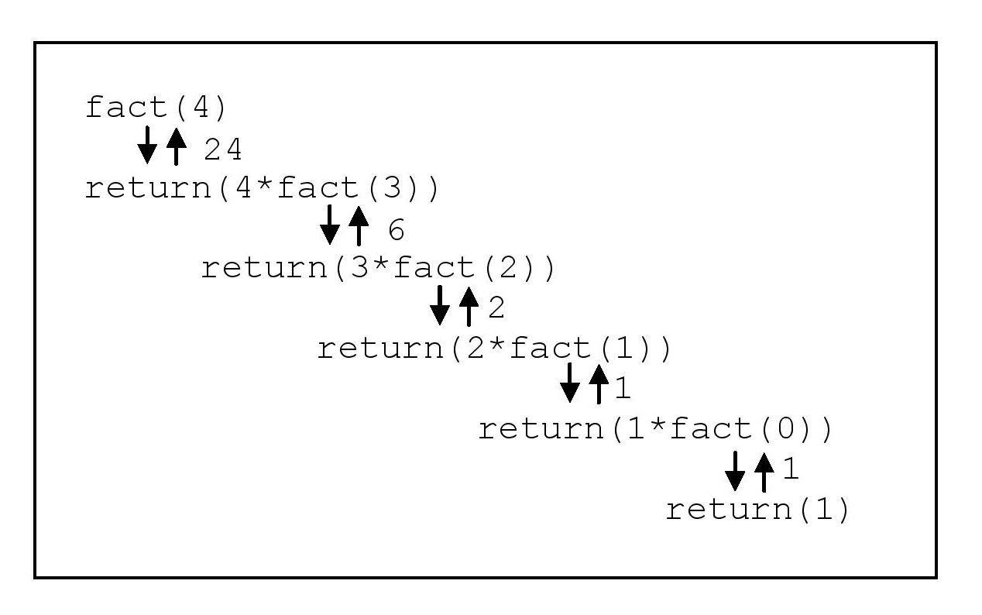
Execution of a recursive function

Slide 24
Lambda function
Have no name
Can be assigned to a variable to give it a name.
A one line version of a function
Can return just one value in the form of an expression
Generally cannot access variable other than arguments
Syntax:
lambda arguments : expression

Slide 25
Lambda function
Example:
  avg = lambda a,b: (a+b)/2
  print(avg(2,3))
print ((lambda a,b: (a+b)/2)(2,3))
Can be used in regular function
def avg(a,b):
return (lambda a,b: (a+b)/2)(a,b)
print(avg(2,3))

Slide 26
Nested lambda function
add= lambda a,b: (a+b)
avg= lambda a,b: add(a,b)/2
print(avg(2,3))
Can be send as argument
def display(x,y,z):
print(x(y,z))
add= lambda a,b: (a+b)
display(add,2,3)

Slide 27
Function redefinition
def func():
print("Hi!!")
func()
def func():
print("Hello!")
func()
def func(str):
print(str)
func("Thanks")
func()
Output:
Hi!!
Hello!
Thanks
Traceback (most recent call last):
File "C:\Python34\test.py", line 13, in <module>
func()
TypeError: func() missing 1 required positional argument: 'str'

Slide 28
Function Annotations
This is nothing but documentation about the arguments and return type of a function
But it does not effect in performance of a function.
To denote annotation a ‘:’ is used with the function arguments and to mention the return type ‘->’ is used after the argument list.
It is optional and if used, set the __annotation__ attribute of a function object which may be used by other tools.
Using annotation we may mention the data type of the arguments and the return type of the function or may mention the possible set of values for the arguments or any other information about the arguments.

Slide 29
Example
def SimpleInterest(p:int, r:float, t:float)->float:
return p*r*t/100
si= SimpleInterest(10000,7.5, 5.5)
print("Simple Interest=", si)
print(SimpleInterest.__annotations__)
Output:
Simple Interest= 4125.0
{'p': <class 'int'>, 'r': <class 'float'>, 't': <class 'float'>, 'return': <class 'float'>}

